Slide 1
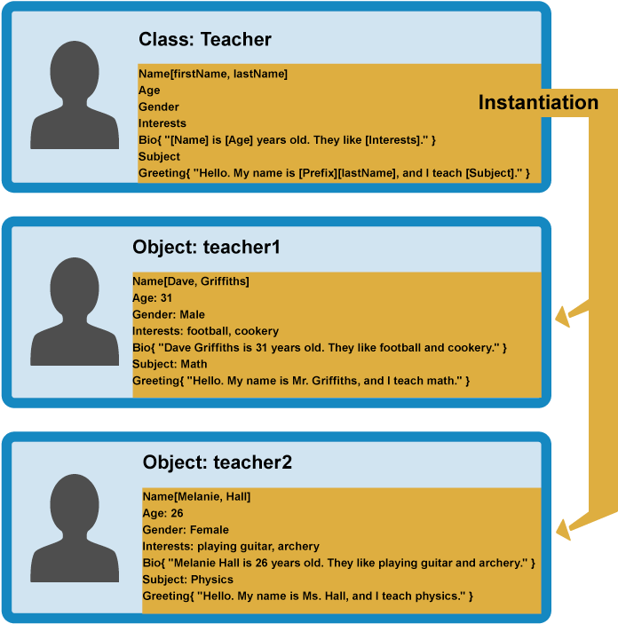
Objects and Classes
Using Objects and Classes Defining Simple Classes
SoftUni Team
Technical Trainers
Software University
https://softuni.bg

Slide 2
Table of Contents
Objects (definition, properties, and methods)
Reference vs. Value Types
Execution context (this)
JSON
Associative Arrays
Classes

Slide 3
Have a Question?
sli.do
#js-front-end

Slide 4

Objects
Definition, Properties and Methods

Slide 5
What Are Objects ?
Structure of related data or functionality
Contains values accessed by string keys
Data values are called properties
Function values are called methods
You can add and remove properties during runtime
Object
'name' | 'Peter'
'age' | 20
Property name (key)
Property value

Slide 6
Object Definition
We can create an object with an object literal
We can define an empty object and add properties later
let person = { name:'Peter', age:20, height:183 };
let person = {};
person.name ='Peter';
person.age = 20;
person.hairColor = 'black';
Access and set properties using string indexation
person['lastName'] = 'Parker';

Slide 7
Problem: Person Info
Create an object that has a first name, last name, and age
Return the object at the end of your function
"Peter",
"Pan",
20
firstName: Peter
lastName: Pan
age: 20
"Jack",
"Sparrow",
"unknown"
firstName: Jack
lastName: Sparrow
age: unknown

Slide 8
Solution: Person Info
Create an object
Set the properties firstName, lastName, and age
Return the created object using the return keyword
function personInfo(firstName, lastName, age) {
let person = {};
person.firstName = firstName;
// TODO: Add other properties
return person;
}

Slide 9
Methods of Objects
Functions within a JavaScript object are called methods
We can define methods using several syntaxes:
We can add a method to an already defined object
let person = { sayHello: function() {
console.log('Hi, guys');
} }
let person = {
sayHello() {
console.log('Hi, guys');
}
}
let person = { name:'Peter', age: 20 };
person.sayHello = () => console.log('Hi, guys');

Slide 10
Built-in Method Library
Get array of all property names (keys)
Get array with of all property values
Get and array of all properties as key-value tuples
cat
'name' | 'Tom'
'age' | 5
Object.keys(cat); // ['name', 'age']
Object.values(cat); // ['Tom', 5]
Object.entries(cat); // [['name', 'Tom'], ['age', 5]]

Slide 11
Problem: City
Receive an object, which holds name, area, population, country, and postcode
Loop through all the keys and print them with their values
Sofia
492
1238438
Bulgaria
1000
name -> Sofia
area -> 492
population -> 1238438
country -> Bulgaria
postCode -> 1000

Slide 12
Solution: City
Get the object entries
Loop through the object entries using for-of loop
Print the object keys and values
function cityInfo(city) { let entries = Object.entries(city); for (let [ key, value ] of entries) { console.log(`${key} -> ${value}`); }
}

Slide 13
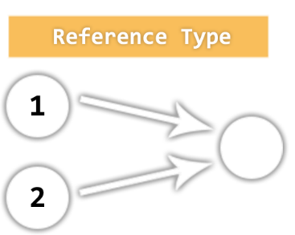
Value vs. Reference Types
Memory Stack and Heap

Slide 14
Reference vs. Value Types
JavaScript has 7 data types that are copied by value:
Boolean, String, Number, null, undefined, Symbol, BigInt
These are primitive types
JavaScript has 3 data types that are copied by having their reference copied:
Array, Objects, and Functions
These are all technically Objects, so we'll refer to them collectively as Objects

Slide 15
Example: Reference vs. Value Types

Slide 16
Value Types
If a primitive type is assigned to a variable, we can think of that variable as containing the primitive value
They are copied by value
let a = 10; let c = a; let b = 'abc'; let d = b;
console.log(a, b, c, d); // a = 10 b = 'abc' c = 10 d = 'abc'

Slide 17
Reference Types
Variables that are assigned a non-primitive value are given a reference to that value
That reference points to a location in memory
Variables don't contain the value but lead to the location
let arr = []; let arrCopy = arr;

Slide 18

Methods and Context
Combine Data with Behavior

Slide 19
Object Methods
Objects can also have methods
Methods are actions that can be performed on objects
Methods are stored in properties as function definitions
let person = {
firstName: "John",
lastName: "Doe",
age: function (myAge) {
return `My age is ${myAge}!` }
};
console.log(person.age(21)); // My age is 21!

Slide 20
Objects as Function Libraries
Related functions may be grouped in an object
The object serves as a function library
Similar to built-in libraries like Math, Object, Number, etc.
This technique is often used to expose public API in a module
// sorting helper
const compareNumbers = {
ascending: (a, b) => a - b;
descending: (a, b) => b - a;
};

Slide 21
Objects as switch replacement
You will almost never see switch used in JS code
Named methods are used instead
let count = 5;
switch (command) {
case 'increment':
count++;
break;
case 'decrement':
count--;
break;
case 'reset':
count = 0;
break;
}
Shorter syntax for object methods
let count = 5;
const parser = {
increment() { count++; },
decrement() { count--; },
reset() { count = 0; }
}
parser[command]();

Slide 22
Accessing Object Context
Functions in JavaScript have execution context
Accessed with the keyword this
When executed as an object method, the context is a reference to the parent object
const person = {
firstName: 'Peter',
lastName: 'Johnson',
fullName() {
return this.firstName + ' ' + this.lastName;
}
};
console.log(person.fullName()); // 'Peter Johnson'

Slide 23
Function Execution Context
Execution context can be changed at run-time
If a function is executed outside of its parent object, it will no longer have access to the object's content
Further lessons will explore more context features!
const getFullName = person.fullName;
console.log(getFullName()); // 'undefined undefined'
const anotherPerson = { firstName: 'Bob',
lastName: 'Smith' };
anotherPerson.fullName = getFullName;
console.log(anotherPerson.fullName()); // 'Bob Smith'

Slide 24
Problem: City Taxes
Extend Problem 1: City Record
Add property taxRate with initial value 10
Add methods:
collectTaxes() increase treasury by (population * taxRate)
applyGrowth(percent) increase population by percentage
applyRecession(percent) decrease treasury by percentage
All values must be rounded down after calculation

Slide 25
Solution: City Taxes
function createRecord(name, population, treasury) {
return {
name, population, treasury,
taxRate: 10,
collectTaxes() {
this.treasury += this.population * this.taxRate;
},
applyGrowth(percent) {
this.population += Math.floor(this.population * percent / 100);
},
applyRecession(percent) {
this.treasury -= Math.floor(this.treasury * percent / 100);
},
};
}

Slide 26

JSON
JavaScript Object Notation

Slide 27
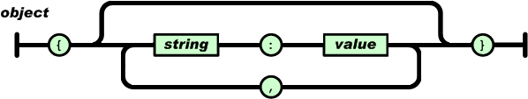
What is JSON
JSON stands for JavaScript Object Notation
Open-standard file format that uses text to transmit data objects
JSON is language independent
JSON is "self-describing" and easy to understand

Slide 28
JSON Usage
Exchange data between browser and server
JSON is a lightweight format compared to XML
JavaScript has built-in functions to parse JSON so it's easy to use
JSON uses human-readable text to transmit data

Slide 29
JSON Example
Brackets define a JSON
{
"name": "Ivan",
"age": 25,
"grades": {
"Math": [2.50, 3.50],
"Chemistry": [4.50]
}
}
It is possible to have nested objects
Keys are in double quotes
Keys and values separated by :
In JSON we can have arrays

Slide 30
JSON Methods
We can convert object into JSON string using JSON.stringify(object) method
We can convert JSON string into object using JSON.parse(text) method
let text = JSON.stringify(obj);
let obj = JSON.parse(text);

Slide 31
Problem: Convert to Object
Write a function, that receives a string in JSON format and converts it to object
Print the entries of the object
'{
"name": "George", "age": 40, "town": "Sofia“
}'
name: George
age: 40
town: Sofia

Slide 32
Tips: Convert to Object
Use JSON.parse() method to parse JSON string to an object
Use Object.entries() method to get object's properties: names and values
Loop through the entries and print them
function objConverter(json) { // TODO: Use the tips to write the function }

Slide 33
Solution: Convert to Object
function objConverter(json) { let person= JSON.parse(json);
let entries = Object.entries(person);
for (let [key, value] of entries) {
console.log(`${key}: ${value}`);
} }

Slide 34
Problem: Convert to JSON
Write a function that receives a first name, last name, hair color and sets them to an object.
Convert the object to JSON string and print it.
'George', 'Jones',
'Brown'
{"name": "George", "lastName": "Jones", "hairColor": "Brown"}

Slide 35
Tips: Convert to JSON
Create an object with the given input
Use JSON.stringify() method to parse object to JSON string
Keep in mind that the property name in the JSON string will be exactly the same as the property name in the object
function solve(name, lastName, hairColor){ // TODO: Use the tips and write the code }

Slide 36
Solution: Convert to JSON
function convertJSON(name, lastName, hairColor) { let person = {
name,
lastName,
hairColor
};
console.log(JSON.stringify(person));
}

Slide 37

Associative Arrays
Storing Key-Value Pairs

Slide 38
What is an Associative Array ?
Arrays indexed by string keys
Hold a set of pairs [key => value]
The key is a string
The value can be of any type
Key
Value
John Smith | +1-555-8976
Lisa Smith | +1-555-1234
Sam Doe | +1-555-5030

Slide 39
Declaration
An associative array in JavaScript is just an object
We can declare it dynamically
let assocArr = {
'one': 1,
'two': 2,
'three': 3,
[key]: 6
};
assocArr['four'] = 4;
assocArr.five = 5;
let key = 'six';
assocArr[key] = 6;
Quotes are used if the key contains special characters
Valid ways to access values through keys

Slide 40
Using for – in
We can use for-in loop to iterate through the keys
let assocArr = {};
assocArr['one'] = 1;
assocArr['two'] = 2;
assocArr['three'] = 3;
for(let key in assocArr) {
console.log(key + " = " + assocArr[key]);
}
// one = 1
// two = 2
// three = 3

Slide 41
Problem: Phone Book
Write a function that reads names and numbers
Store them in an associative array and print them
If the same name occurs, save the latest number
['Tim 0834212554',
'Peter 0877547887',
'Bill 0896543112',
'Tim 0876566344']
Tim -> 0876566344
Peter -> 0877547887
Bill -> 0896543112

Slide 42
Solution: Phone Book
function solve(input) {
let phonebook = {}; for (let line of input) { let tokens = line.split(' '); let name = tokens[0]; let number = tokens[1]; phonebook[name] = number; } for (let key in phonebook) { console.log(`${key} -> ${phonebook[key]}`); } }

Slide 43
Manipulating Associative Arrays
Check if a key is present:
Remove entries:
let assocArr = { /* entries */ };
if (assocArr.hasOwnProperty('John Smith')) { /* Key found */ }
delete assocArr['John Smith'];

Slide 44
Problem: Meetings
Write a function that reads weekdays and names
Print a success message for every successful appointment
If the same weekday occurs a second time, print a conflict message
In end, print a list of all meetings
See example input and output on next slide

Slide 45
Example: Meetings
Parsing input and success/conflict messages
Final list output
['Monday Peter',
'Wednesday Bill',
'Monday Tim',
'Friday Tim']
Scheduled for Monday
Scheduled for Wednesday
Conflict on Monday!
Scheduled for Friday
Monday -> Peter
Wednesday -> Bill
Friday -> Tim

Slide 46
Solution: Meetings
function solve(input) {
let meetings = {};
for (let line of input) {
let [weekday, name] = line.split(' ');
if (meetings.hasOwnProperty(weekday)) {
console.log(`Conflict on ${weekday}!`);
} else {
meetings[weekday] = name;
console.log(`Scheduled for ${weekday}`);
}
}
// TODO: Print result
}

Slide 47
Sorting Associative Arrays
Objects cannot be sorted; they must be converted first
Convert to array for sorting, filtering and mapping:
let phonebook = { 'Tim': '0876566344',
'Bill': '0896543112' };
let entries = Object.entries(phonebook);
console.log(entries); // Array of arrays with two elements each
// [ ['Tim', '0876566344'],
// ['Bill', '0896543112'] ]
let firstEntry = entries[0];
console.log(firstEntry[0]); // Entry key -> 'Tim'
console.log(firstEntry[1]); // Entry value -> '0876566344'
The entry is turned into an array of [key, value]

Slide 48
Sorting By Key
The entries array can be sorted, using a Compare function
To sort by key, use the first element of each entry
You can also destructure the entries
entries.sort((a, b) => {
keyA = a[0];
keyB = b[0];
// Perform comparison and return negative, 0 or positive
});
entries.sort(([keyA, valueA],[keyB, valueB]) => {
// Perform comparison and return negative, 0 or positive
});

Slide 49
Problem: Sort Address Book
Write a function that reads names and addresses
Values will be separated by ":"
If same name occurs, save the latest address
Print list, sorted alphabetically by name
['Tim:Doe Crossing',
'Bill:Nelson Place',
'Peter:Carlyle Ave',
'Bill:Ornery Rd']
Bill -> Ornery Rd
Peter -> Carlyle Ave
Tim -> Doe Crossing

Slide 50
Solution: Sort Address Book
function solve(input) {
let addressbook = {};
for (let line of input) {
let [name, address] = line.split(':'); addressbook[name] = address;
} let sorted = Object.entries(addressbook);
sorted.sort((a, b) => a[0].localeCompare(b[0]));
// TODO: Print result
}

Slide 51
Array and Object Destructuring
The destructuring assignment syntax makes it possible to unpack values from arrays, or properties from objects, into distinct variables.
Оn the left-hand side of the assignment to define what values to unpack from the sourced variable.
obj = { a: 1, b: 2 };
const { a, b } = obj;
// is equivalent to:
// const a = obj.a;
// const b = obj.b;
const x = [1, 2, 3, 4, 5];
const [y, z] = x;
console.log(y); // 1
console.log(z); // 2

Slide 52
Sorting By Value
To sort by value, use the second element of each entry
You can also destructure the entries
entries.sort((a, b) => {
valueA = a[1];
valueB = b[1];
// Perform comparison and return negative, 0 or positive
});
entries.sort(([keyA, valueA],[keyB, valueB]) => {
// Perform comparison and return negative, 0 or positive
});

Slide 53

Classes
Object Models

Slide 54
What are Classes?
Templates for creating objects
Defines structure and behavior
An object created by the class pattern is called an an instance of that class
A class has a constructor – method called automatically to create an object
It prepares the new object for use
Can receive parameters and assign them to properties

Slide 55
Class Declaration
Use the class keyword followed by a name
class Student {
constructor(name) {
this.name = name;
}
}
The constructor is a special method for creating and initializing an object

Slide 56
Class Example
Creating a class:
Creating an instance of the class:
class Student {
constructor(name, grade) {
this.name = name;
this.grade = grade;
}
}
this keyword is used to set a property of the object to a given value
let student = new Student('Peter', 5.50);

Slide 57
Functions in a Class
Classes can also have functions as property, called methods:
class Dog {
constructor(name) {
this.name = name;
}
speak() {
console.log(`${this.name} says Woof!`);
}
}
let dog = new Dog('Sparky');
dog.speak(); // Sparky says Woof!
this in the object refers to itself
We access the method as a regular property

Slide 58
Problem: Cat
Write a function that receives array of strings in the following format: '{cat name} {age}'
Create a class Cat that receives the name and the age parsed from the input
It should also have a method named meow() that will print "{cat name}, age {age} says Meow" on the console
For each of the strings provided you must create a cat object
['Mellow 2','Tom 5']
Mellow, age 2 says Meow
Tom, age 5 says Meow

Slide 59
Tips: Cat
Create a class
Set properties name and age
Set property 'meow' to be a method that prints the result
Parse the input data
Create all objects using the class constructor and the parsed input data and store them in an array
Loop through the array using for…of loop and invoke .meow() method

Slide 60
Solution: Cat
function catCreator(arr) { // TODO: Create the Cat class
let cats = [];
for (let i = 0; i < arr.length; i++) { let catData = arr[i].split(' '); cats.push(new Cat(catData[0], catData[1]));
}
// TODO: Iterate through cats[] and invoke .meow() using for…of loop
}

Slide 61

Live Exercises

Slide 62

Summary
Objects hold key-value pairs
Access value by indexing with key
Methods are functions
References point to data in memory
Parse and stringify objects in JSON
Classes are templates for objects
Objects hold key-value pairs
Access key and value
Use Object Methods
Value vs. Reference types
Parse and stringify objects in JSON
Classes

Slide 63
Questions?
Notes:
63

Slide 64














SoftUni Diamond Partners

Slide 65

Educational Partners

Slide 66
Trainings @ Software University (SoftUni)
Software University – High-Quality Education, Profession and Job for Software Developers
softuni.bg
Software University Foundation
softuni.foundation
Software University @ Facebook
facebook.com/SoftwareUniversity
Software University Forums
forum.softuni.bg
Notes:
66

Slide 67

License
This course (slides, examples, demos, exercises, homework, documents, videos and other assets) is copyrighted content
Unauthorized copy, reproduction or use is illegal
© SoftUni – https://about.softuni.bg/
© Software University – https://softuni.bg
Notes:
67

